Slide 1
A computer is a machine that can be programmed to carry out sequences of arithmetic or logical operations (computation) automatically. Modern digital electronic computers can perform generic sets of operations known as programs. These programs enable computers to perform a wide range of tasks. A computer system is a nominally complete computer that includes the hardware,

Slide 2
What is computer
used to build web applications or websites.14 Jan 2021What is the full form of PHP? The full form of PHP is Hypertext Preprocessor. It was abbreviated previously as Personal Home Page. It is a programming language widely used to build web applications or websites.14

Slide 3
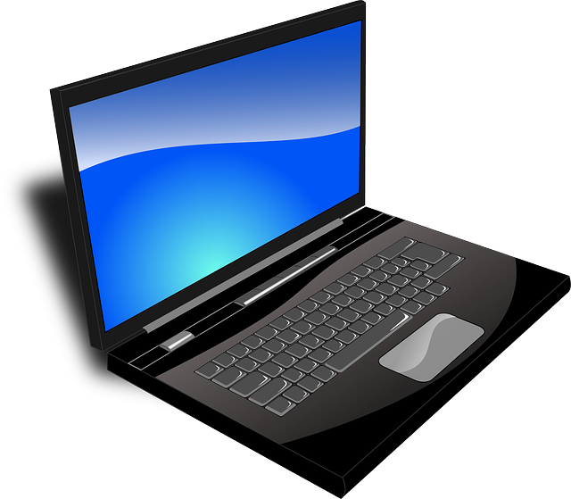
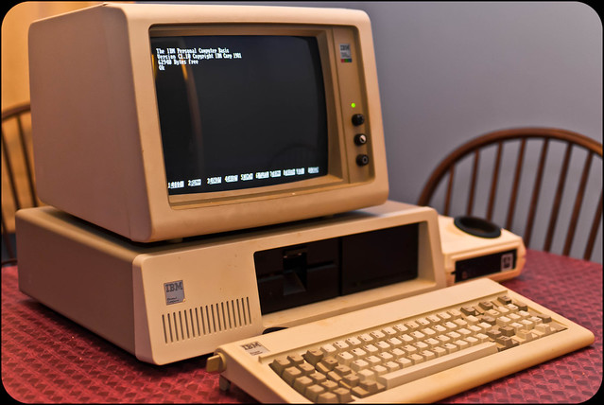
Picture of computers

Slide 4
A keyboard comes in different formats to house the letters, characters, and symbols that you use to input text into a computer or smartphone
QWERTY vs. Alternative Keyboard Layouts: QWERTY is the most common keyboard layout, but there are alternative layouts such as Dvorak and Colemak that claim to be more efficient
What is keyboard

Slide 5
Difference between keyboard and mouse
keyboard
mouse
A wireless keyboard is a computer keyboard that allows the user to communicate with computers,
A mouse is a small rodent. Characteristically, mice are known to have a pointed snout, small rounded ears, a body-length scaly tail, and a high breeding rate

Slide 6
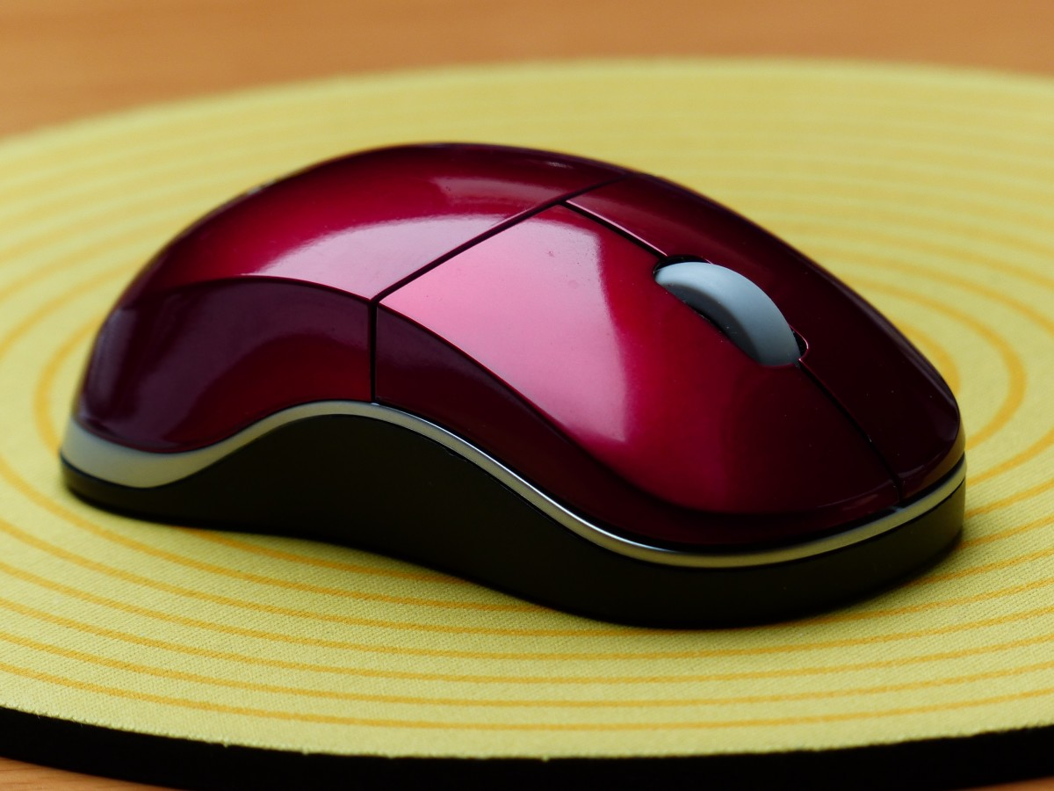
mouse
Mouse
Viewing Definition section. More definitions.
Mouse
noun
a small rodent that typically has a pointed snout, relatively large ears and eyes, and a long tail.

Slide 7
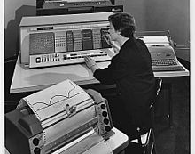
2ndgeneration computer
Transistor computer
A transistor computer, now often called a second-generation computer, is a computer which uses discrete transistors instead of vacuum tubes. The first generation of electronic computers

Slide 8
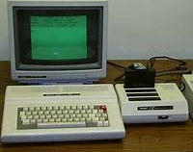
3rd generation computer
Technology Expert Last updated: 13 July, 2015 Disclosure Why Trust Us What Does Third Generation Computers

Slide 9
Comparison between 2nd and 3rd generation computer
2nd generation computer
3rd generation computer
In the analog world of continuously varying frequencies, a transistor amplifies a weak electrical signal to drive a speaker. In the digital world, a transistor is an on/off switch and the fundamental building block of computer circuitry. Like a light switch on the wall, a transistor either prevents or allows current to flow through.
The Foundation of All A
Instead of using individual transistors, the computers made in the third …
As compared to second-generation computers, 3rd generation computers …
High-level programming languages such as ALGOL-68, FORTRAN-II TO IV, …
These computers were introduced with magnetic.

Slide 10
Hard ware
Hardware and software are two categories of a computer system¹. Hardware is the physical and visible components of a computer¹, such as a monitor, CPU, keyboard and mouse²³¹. Software is a set of instructions that tell the hardware what to do and how to do it³¹⁴. Software is installed on the computer's hard drive and cannot be touched⁵. Hardware and software need each other to function properly

Slide 11
Software
It is a collection of data that is given to the computer to complete a particular task. The chart below describes the types of software: Above is the diagram of types of software. Now we will briefly describe each type and its subtypes: 1. System Software 1.1. Operating System 1.2. Language Processor 1.3. Device Driver 2. Application Software 2.1. ...

Slide 12
Thank you

